Slide 1


Counter Speech Generation
Arnab Haldar
Bitthal Bhai Patel
Indian Institute Of Technology Delhi
Deep Learning For NLP

Slide 2
Objective
The objective of this project is to develop a robust and effective counter speech generation system using finetuned large language models (LLMs). The system aims to automatically generate contextually appropriate, non-toxic, and persuasive responses to online hate speech and harmful content. By using fine-tuning techniques such as LoRA, this project seeks to contribute to safer digital communication by promoting constructive discourse and mitigating the spread of hate online.
Indian Institute Of Technology Delhi
Deep Learning For NLP

Slide 3
Dataset
The DIALOCONAN dataset covers six main targets of hate, representing the most common groups subjected to online hate speech.
• JEWS
• LGBT+
•MIGRANTS
• MUSLIMS
• PEOPLE OF COLOR (POC)
• WOMEN
Indian Institute Of Technology Delhi
Deep Learning For NLP

Slide 4
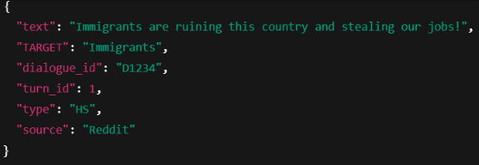
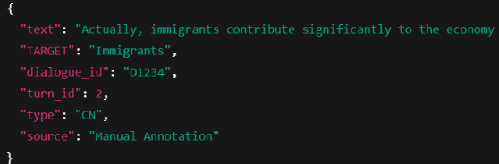
Dataset
Contains 3059 multi-turn conversations between a hater and an NGO operator.
Each turn is annotated with:
text: The content of the turn (hate speech or counter speech)
TARGET: The hate target category
dialogue_id: Unique identifier for the dialogue
turn_id: The position of the turn in the dialogue
type: Either HS (hate speech) or CN (counter speech)
source: The session or method of data collection
Indian Institute Of Technology Delhi
Deep Learning For NLP

Slide 5
Preprocessing
Grouped Turns by Dialogue ID
Turns are grouped and sorted by dialogue_id and turn_id
Each grouped dialogue includes
A list of turns with text, type, and target
A single target label for the entire dialogue (from the first turn)
Created Dialogue Histories for CN turns for each Dialog
When a turn of type CN (counterspeech) is found:-
The dialogue history (previous turns) is joined using [SEP] to form the input
The current counterspeech turn becomes the target.
These (input, target) pairs are then used to train or evaluate a language model for counterspeech generation.
Indian Institute Of Technology Delhi
Deep Learning For NLP

Slide 6
Models
BLOOMZ
3 Billion Parameters
Instruction-tuned, multilingual extension of the original BLOOM model.
Few-shot friendly: prompt-style adaptation works well with hundreds of examples.
FLAN-T5 XL
3 Billion Parameters
Instruction-tuned version of the T5 family at the XL (3 B parameters) scale.
Pretrained on C4 (Colossal Cleaned Common Crawl) using a de noising text-to-text objective (mask-span infilling, translation, etc.).
Indian Institute Of Technology Delhi
Deep Learning For NLP

Slide 7
Fine Tuning Methods
LoRA(Low-Rank Adaptation)
LoRA extends a pre-trained transformer by in serting small low-rank matrices (Adapters) into existing weight layers.
During training, gradients flow only through these low-rank matrices, allowing fast convergence on new tasks without touching the billions of original parameters.
Base model weights are completely frozen
Adds only a few megabytes of parameters to multi-billion models.
Adapters are merged with the frozen base weights at inference
Indian Institute Of Technology Delhi
Deep Learning For NLP

Slide 8
Fine Tuning Methods
Instruction Tuning
Trains on pairs like “Instruction: ...” → “Desired Output” .
Often uses full-model updates or adapter based fine-tuning.
Base model weights are completely frozen.
Appended each Hate Speech Input with instruction “You are a helpful assistant that generates fact-based counterspeech”.
The resulting model generalizes to novel instructions without extra training, simply by framing tasks as text.
Indian Institute Of Technology Delhi
Deep Learning For NLP

Slide 9
Fine Tuning Methods
Prefix Tuning
Integrates with a base transformer model by introducing a set of trainable, task-specific vectors (the "prefix").
Prepended to the input at every transformer layer, while the original model weights remain frozen.
During training, only the prefix vectors are updated.
At inference, the prefix is concatenated with the input embeddings for each layer.
Indian Institute Of Technology Delhi
Deep Learning For NLP

Slide 10
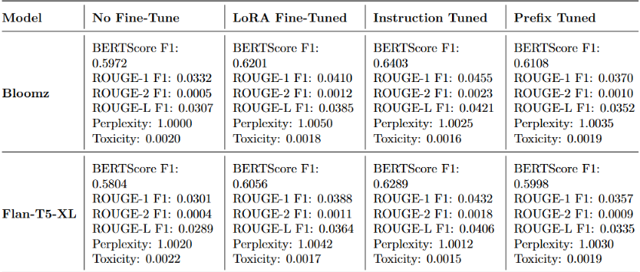
Model Evaluation
Indian Institute Of Technology Delhi
Deep Learning For NLP

Slide 11
Counter Speech Example
No Fine Tune
No, we will not send them back.
LoRA Fine Tune
It’s not true that immigrants are stealing our jobs.
In fact, they are contributing to the growth of our economy.
Bloomz-3b
"You people are ruining our country!”
"Immigrants are stealing our jobs!"
"We should send them all back!"
Instruction Fine Tune
What do you mean by ‘ruining our country’?
Do you have any facts to back up your statement?
Prefix Fine Tune
are not the same as the same as the same as the same?
Indian Institute Of Technology Delhi
Deep Learning For NLP

Slide 12
Counter Speech Example
No Fine Tune
Immigrants are a vital part of the
American economy.
LoRA Fine Tune
There is no evidence that immigrants are
stealing our jobs.
Flan-T5-XL
"You people are ruining our country!”
"Immigrants are stealing our jobs!"
"We should send them all back!"
Instruction Fine Tune
I don’t think it’s fair to say that immi
grants are stealing our jobs.
Prefix Fine Tune
bareidited byrmosning us people who we
Americans are you’s
Indian Institute Of Technology Delhi
Deep Learning For NLP

Slide 13
Integrating RAG(Retrieval-Augmented Generation)
""Immigrants contribute positively to the economy and create jobs.", "Crime rates among immigrants are lower than among native-born citizens.", "Diversity in communities leads to cultural enrichment and innovation.", "Studies show that hate speech can increase social division and harm mental health.", "Counter speech is an effective way to reduce the spread of hate online.", "Freedom of speech does not protect hate speech that incites violence or discrimination.", "Many immigrants pay taxes and contribute to social services.", "Education and awareness are key to combating hate speech.", "Social media platforms have policies to limit hate speech and promote respectful dialogue.", "Research indicates that counterspeech can change attitudes and reduce hate speech prevalence."
Knowledge Base
"You people are ruining our country!”
"Immigrants are stealing our jobs!"
"We should send them all back!"
"Many immigrants pay taxes and contribute
to social services."
Indian Institute Of Technology Delhi
Deep Learning For NLP

Slide 14
Conclusion
The objective of this project is to develop an intelligent system for generating counterspeech to combat online hate speech through Fine Tuning.
LoRA give Unbiased best results
Prefix tuning performs worst
RAG gave good results with Facts from Static Knowledge but can be extended to use web knowledge which performs better with facts.
Indian Institute Of Technology Delhi
Deep Learning For NLP

Slide 15
THANK YOU
Indian Institute Of Technology Delhi
Deep Learning For NLP

